Slide 1
Chapter 6: Reliability (Part 2)

Slide 2
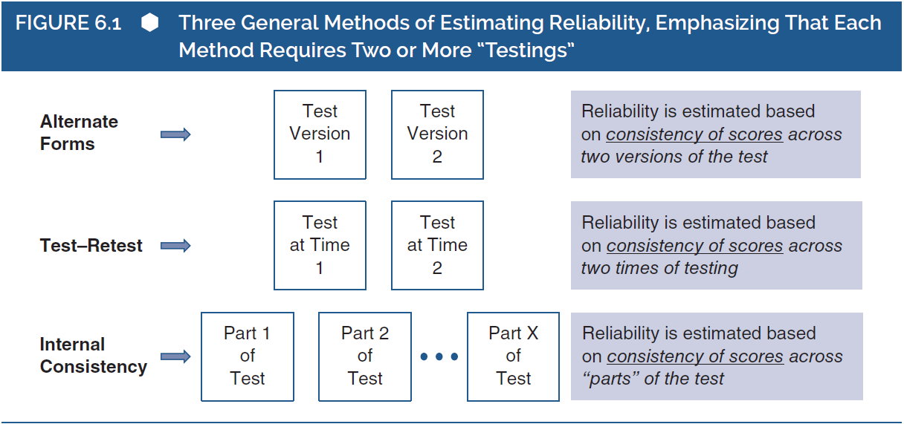
Assessing Reliability (1 of 4)
Notes:
Figure 6.1: Three general methods of estimating reliability, emphasizing that each method requires two or more “testings.”

Slide 3
Assessing Reliability (2 of 4)
Conditions for parallel test forms:
  Should measure identical test scores
  Have the same amount of error variance
  If yes to above, correlation between scores == reliability
Problem?
  We can never be 100% certain that alternate forms of a test are exactly parallel…
  Alternate forms may also not measure the same construct
Notes:
Consistency in differences between scores:
The alternate forms reliability (or) parallel forms reliability method used for estimation of reliability works by computing the correlation between scores obtained from two different test forms.
The correlation thus obtained is an estimate of reliability and is accurate only when the test forms are parallel.
Conditions for parallel test forms:
For two test forms to be parallel, they should measure identical test scores and have the same amount of error variance.
In this case, the correlation between two parallel tests is exactly equal to the reliability of the test scores.
Practical problem in alternate forms:
We can never be entirely confident that alternate forms of a test are truly parallel.
This is due to the fact that no two tests can be ascertained of meeting the assumptions of CTT or parallel tests.
Assessing the same psychological construct:
In addition to the practical issue, alternate forms of a test may not always measure the same psychological construct.
For example, the two test forms may measure slightly different attributes like socially derived self-esteem versus a nonsocial self-esteem.
This implies that the true scores on the first form are not strictly equal to the corresponding true scores on the second form, thus establishing the two test forms are not truly parallel.

Slide 4
Assessing Reliability(3 of 4)
Repeated testing
Potential Problems?
  Potential carryover effects
  Error scores might be correlated
Notes:
Contamination due to repeated testing:
When two tests are taken simultaneously, there is a potential for carryover or contamination effects.
This leads to the error scores on the test forms to be correlated.
This turns into an issue because a fundamental assumption of CTT is that the error affecting any test is random, thus making the error scores uncorrelated.
Therefore, the tests end up violating the most assumption of CTT and proving to be not truly parallel.
Hypothetical case of carryover problem:
The data represented possess the qualities needed to establish that the two forms are equally reliable.
In the omniscient state, the reliability of both sets of scores in determined to be the same.
Therefore, the correlation between the two forms’ observed scores should be exactly equal to the reliability, if the tests are truly parallel.
However, the data show that error scores of the two forms are strongly correlated, thus violating the fundamental assumption about the nature of error scores.
This violation is a result of the carryover effect (which is probably the mood state or memory in this case).
Strong correlation between observed scores:
The correlation of two sets of observed scores is influenced by the fact that the two sets of error scores are correlated with each other.
Since the correlation between the observed scores from the two forms is quite strong, the correlation between the alternate forms would be inaccurate as the reliability.
Ascertaining that tests are parallel:
For two test forms to be parallel, they must fit into certain criteria.
Tests forms with the identical observed score means and standard deviations and with the confidence that they are both measuring the same psychological construct, then the tests can be considered as close to parallel.
Once this has been established, we can have an alternate forms estimate of reliability.

Slide 5
Assessing Reliability (4 of 4)
How to know if tests are truly parallel?
  Observed scores: Identical means and SDs
  Both tests were designed to measure the same construct
Notes:
Contamination due to repeated testing:
When two tests are taken simultaneously, there is a potential for carryover or contamination effects.
This leads to the error scores on the test forms to be correlated.
This turns into an issue because a fundamental assumption of CTT is that the error affecting any test is random, thus making the error scores uncorrelated.
Therefore, the tests end up violating the most assumption of CTT and proving to be not truly parallel.
Hypothetical case of carryover problem:
The data represented possess the qualities needed to establish that the two forms are equally reliable.
In the omniscient state, the reliability of both sets of scores in determined to be the same.
Therefore, the correlation between the two forms’ observed scores should be exactly equal to the reliability, if the tests are truly parallel.
However, the data show that error scores of the two forms are strongly correlated, thus violating the fundamental assumption about the nature of error scores.
This violation is a result of the carryover effect (which is probably the mood state or memory in this case).
Strong correlation between observed scores:
The correlation of two sets of observed scores is influenced by the fact that the two sets of error scores are correlated with each other.
Since the correlation between the observed scores from the two forms is quite strong, the correlation between the alternate forms would be inaccurate as the reliability.
Ascertaining that tests are parallel:
For two test forms to be parallel, they must fit into certain criteria.
Tests forms with the identical observed score means and standard deviations and with the confidence that they are both measuring the same psychological construct, then the tests can be considered as close to parallel.
Once this has been established, we can have an alternate forms estimate of reliability.

Slide 6
Test–Retest Reliability (1 of 3)
Method: The same set of people take the same test on at least two occasions
If used appropriately, reliability can be computed as the correlation between times 1 and 2
This approach assumes that tests are parallel
Must be careful about temporary events that could change error variance!
Notes:
Test–retest reliability:
This method can be used to avoid few problems that we counter while using the alternate forms method.
The test–retest method is ideal for measuring stable psychological constructs, like intelligence or extroversion.
Determination of reliability:
In the test–retest approach, the same set of people are made to take the same test in two or more different occasions.
When the assumptions are made safely, then the correlation between the test scores from the first test and the retest can be interpreted as an estimate of the reliability of the test.
Meeting the criteria for parallel tests:
Test–retest method also rests on the assumption that the two tests meet the criteria for parallel tests.
First, the researcher must be confident that true scores do not change from the first time they take the test to the second time.
Second, the error variances of the first testing and the second testing must be equal.
When the above two assumptions are legitimate, then we can establish that correlation between scores from the two tests is an accurate estimate of reliability.
Meeting the second assumption about error variance:
For the researcher to be confident that the second assumption about error variance is met, care must be taken in the testing process with regard to temporary elements that can affect the responses.
When the testing situations are set up carefully, the researcher may be able to reasonable confidence that responses are affected by error to the same degree.

Slide 7
Test–Retest Reliability (2 of 3)
Potential Problems:
  Participants might experience psychological changes between test times
    Could potentially change true scores
    Should only be used with stable psychological constructs (Intelligence, extraversion, etc.)
    Long periods of time between test should be avoided!
  Too short between test times is also a problem
    Carry over effects!
Notes:
Ensuring meeting the first assumption:
To be confident about the first assumption is relatively more difficult.
This is because, respondents often experience psychological changes between occasions, thus leading to changes in true scores.
Instability of psychological attributes:
First factor to affect stability assumption.
Some psychological attributes are unstable across time.
For instance, consider a test of mood states.
The mood state of an individual can change within minutes based on the news they hear, some form of physical distress, or so on.
The mood of individuals taking the test and retest may therefore fluctuate with time, thus resulting in their true construct levels being unstable across the two tests.
This leads to a poor estimate of test reliability.
Measuring stable attributes:
The researcher can be confident about the stability of the construct, when the one measured is a trait-like, stable psychological attribute like intelligence.
In this case, there is empirical evidence to suggest that intelligence is highly stable from middle childhood through adulthood and therefore the true scores cannot be altered during the test–retest interval.
Effect of the length of test–retest interval:
The second factor that can affectpsychological change.
When the test–retest interval spans across years or months, there is a higher chance of change in true scores.
However, when the interval is too confidence is the length of the test–retest interval that can, in all probability, bring in small, there is the risk of the carryover effect.

Slide 8
Test–Retest Reliability (3 of 3)
Time period of the interval
  Certain periods of life == different rates of change
  Example?
Challenges with instability
  Never possible to be 100% sure about the stability of scores over the interval
  If scores are unstable, test is measuring two (or more) independent constructs
  Important to take proper care when interpreting test-retest reliability!
Notes:
Time period of the interval:
The third factor that can affect confidence of researcher is the time period during which the interval occurs.
Psychological changes are more likely to occur at certain periods of an individual’s lifetime.
For instance, cognitive skills of an individual is likely to change more during the school-age rather than during adulthood.
These kinds of changes, where people’s true scores change at different rate can violate an important assumption of parallel tests thus yielding an inaccurate estimate of reliability.
The stability coefficient:
Since the test–retest reliability approach is heavily dependent upon the assumption about stability of true scores across the test interval, the correlation coefficient of the test is referred to as stability coefficient.
Clearly, when the test scores are stable during the interval, the test–retest correlation showcases just the effect of measurement error, making the estimation of reliability rather straightforward.
Challenges with instability:
It is not possible to be 100% sure about the stability of true scores in the test–retest interval.
When the true scores are instable, then the correlation represents two independent factors, the extent to which measurement error affect the test and the degree of change in true scores.
It is, however, impossible to separate the two independent factors and the combined effect of measurement error and true score instability makes the test–retest correlation a poor estimate of the test’s reliability.
The important point here is to ensure proper care (with regard to reliability and to the likely stability of the underlying construct) while interpreting the test–retest correlation.
Limited applicability of alternate forms and test–retest approaches:
Both the approaches have solid theoretical foundations for the estimation of reliability.
However, both approaches have practical difficulties such as being time-consuming, expensive, and so on.
Another drawback is that, both test forms depend upon the validity of the parallel tests model.
This clearly implies that both forms have somewhat limited applicability.

Slide 9
Internal Reliability
Notes:
Figure 6.1: Three general methods of estimating reliability, emphasizing that each method requires two or more “testings.”

Slide 10
Internal Consistency Reliability
(1 of 6)
Reliability between a set of scores from one test, rather than comparing between tests.
Different parts of the same test are treated as unique tests
Advantages:
  Participants take test once, so no issues w/ stability
  Can be used on composite score
Factors that affect internal reliability:
  Consistency in observed scores between different parts of test
  Length of test
    (longer test == more likely to be reliable, why?)
Notes:
Advantages of internal consistency approach:
It is used to estimating reliability and acts as a practical alternative to the tests discussed previously.
The test requires respondent to take the test only once, thus simplifying the process and nullifies the issues around stability.
The test can be applied to composite test scores too (multiple-item tests).
In this approach, different parts of a test are treated as different forms of tests and is one the most widely used method for estimating reliability.
Factors that affect reliability:
According to the internal consistency approach, there are two important factors that can affect the reliability of the test scores.
The consistency in observed scores among the different parts of the tests.
Length of the test: The longer the test, the more likely it is to produce reliable scores.
Approaches to the internal consistency method:
Three well-known approaches to the internal consistency method of reliability estimation exist.
They are, the split-half approach, the “raw alpha” approach and the “standardized alpha” approach.
The shortcomings in these approaches leads us to the discussion another alternative approach called “omega.”

Slide 11
Internal Consistency Reliability
(2 of 6)
Split-Half Estimates of Reliability
  Divides a single test into two equal, parallel subtests
  Reliability = correlation of scores between subsets
Accuracy depends on the assumption that two halves are parallel
Other problems?
  Deciding how to split the test
  Depending on how you split it up, you could get different results!
Notes:
Creating parallel subsets:
In this method, a single test in divided into two equal, parallel subtests.
A score is computed for each subtest and the correlation of the two scores is used to estimate reliability.
Clearly, the process involves splitting a test, and hence the name.
Steps involved in the split-half method:
The first step in the process is the creation of two subtest scores.
In the second step, the correlation between the two subtests is computed.
The split-half correlation reflects the degree to which the two parts of the test are consistent with each other.
Finally, the split-half correlation is entered into a formula to compute the reliability estimate.
Formulas for estimating reliability:
Several formulas are used to calculate the reliability estimate from the split-half correlation.
These formulas go by different names like the Spearman–Brown split-half formula, the Spearman–Brown prophecy formula, and so on.
The most commonly used form of the formula is $R_{XX}=\frac{2r_{hh}}{1+r_{hh}}$.
Reason to use a special formula:
Unlike the other two test forms, where the correlation is taken as the estimate of reliability, the internal consistency approach requires the correlation to be fed into a special formula to calculate the reliability estimate.
This is because, the internal consistency approach involves two halves of the same test, rather than different tests or one complete test taken twice.
Therefore, this formula is needed to take the correlation between the two subtests and “step up” to an estimate of the reliability of the complete test.

Slide 12
Internal Consistency Reliability
(3 of 6)
“Raw” Coefficient Alpha
  Item-level approach: each item taken as a subset.
  Reliability = consistency between all items
Notes:
Item-level approach:
In the item-level approach, each item of the test is taken as a subtest.
Therefore, the consistency among all items is used to estimate the reliability of the complete test.
From this perspective several approaches can be used to estimate reliability.
These approaches differ in their applicability to different response formats, data that meet different assumptions and in the use of different forms of data.
Two-step process in item-level approach:
First step:
To understand the approach better, we use hypothetical data for a four-item test to calculate the variance of scores and then the covariance between each pair of items.
The resultant matrix of covariances among the four items is then examined.
If the test is measuring a single construct, then it is expected that all items positively covary with each other.
Finally, all the pairwise covariances are summed.
Greater the sum of interitem covariances, the more consistent the items are with each other.
The second step:
The second step involves the calculation of the reliability estimate by applying the variance of the scores on the complete test and the sum of the covariances into the following equation, $α= estimatedR_{XX}=\left(\frac{k}{k−1}\right)\left(\frac{\sum{{c_{ii}}_{′}}}{s_{x}^{2}}\right)$.
Statistical software programs can also be used to compute reliability estimates by using raw alpha.
For example, the software, SPSS’s Reliability Analysis procedure gives the reliability estimate in the name of “Cronbach’s Alpha.”
Drawing generalizations for wider population:
Sometimes, test developers wish to draw general inferences beyond the sample in hand.
In other words, test users may want to use the alpha value from their test sample and take the best guess of alpha for a wider population.

Slide 13
Internal Consistency Reliability
(4 of 6)
“Raw” Coefficient Alpha
  Reasons for a negative alpha estimate.
    Reverse score items?
    Wrong test?
Notes:
Points to be noted for confidence interval:
Confidence interval is wide and imprecise when the sample size is very small.
The confidence interval includes a negative value, which is not consistent with the conceptual definition of reliability.
Reasons for a negative alpha estimate:
A negative alpha estimate may be the result of a wrong test that needs revision.
Also, another possible reason would be that one or more items need to be reverse scored.
Software packages as a better option:
Obtaining confidence intervals involves computation complexity.
The software packages appear to be well equipped for determining confidence intervals, thus making them the better option.
Discussion about inferential procedures:
From the discussion about confidence intervals, we move onto inferential procedures related to alpha that have been developed to evaluate multiple issues.
Many software packages incorporate these procedures and therefore interested readers are recommended to take up the task on their own, after sufficient research about the computation process.

Slide 14
Internal Consistency Reliability
(5 of 6)
“Standardized” Coefficient Alpha
  Same as raw, but used when test scores are standardized (e.g., z-scores)
Standardized is a better choice for composite tests
Notes:
Suitability of the test:
The standardized alpha estimate test (also referred to as generalized Spearman–Brown formula) is closely related to raw alpha and is most appropriate for tests where responses are standardized (converted into z scores).
This is done by before the summing or averaging the responses.
Need for standardization:
When the items in a test have dramatically different variances, then the responses may have to be standardized.
This is because, such vast differences in variances will lead to the test being more heavily weighted to reflect the content and meaning of items with the largest variabilities.
Issues in differential weighting:
Sometimes, differential weighting of items do not cause any trouble.
However, in some case, for instance, when items are on different response scales or when if scores from different measures were combined to form a new composite measure.
In such cases, standardization would be appropriate and the standard alpha test for estimation of reliability will be apt.
Importance of standardized alpha method.
Standardized alpha is clearly the better choice (than raw alpha) for a “two-item” composite test.
It offers a more straightforward perspective of reliability and presents the value in the most fundamental and intuitive form.
This may probably be due to the fact that standardized alpha procedure relies on correlations, rather than on less intuitive concepts like variances and covariances.

Slide 15
Internal Consistency Reliability
(6 of 6)
Does high internal reliability mean that a test is unidimensional (i.e., it only measures one thing?)
  Not necessarily!
  Multidimensional tests can also have high internal reliability!
    What if items belonging to one set are highly correlated w/ each other and moderately correlated with items assessing a different construct?
Notes:
Indication of unidimensional test:
Sometimes, a high value of internal consistency reliability is assumed to be an indication of a unidimensional or conceptually homogenous test.
This is an invalid interpretation and idea about linking the two must be abandoned.
High internal consistency in multidimensional tests:
A multidimensional test (conceptually heterogenous) can also have a high internal consistency reliability.
For instance, when a test has two sets of items (a composite test), it may so happen that items within the set correlate well with one another and weakly with items of another set.
Thus, it is not a good idea to treat an internal consistency estimate of reliability as a measure of the conceptual homogeneity or dimensionality of the test.

Slide 16
Reliability of Difference Scores
(1 of 8)
So far focus has been on a single test. What about the difference between two test scores?
Example progress in a reading program, effectiveness is assessed by comparing before and after scores
How much of the change from time 1 to 2 is due to the intervention and how much is due to random error?
Notes:
Understanding differences between test scores:
While we have thus far been concentrating on a single test and its reliability estimate, there may be reasons to be interested in the difference between two scores.
For example, to analyze the progress of a reading program, the reading skills of students may be tested before and after the program.
Thus, there is a clear interest in studying the change in students’ test scores and this further gives rise to a number of questions, with the most important ones directed toward variability.
In other words, the researchers may want to quantify the variability and understand whether any psychological variables are associated with the change.
Analysis of questions and its importance:
Difference in scores arises many behavioral questions.
Most questions are directed toward variability.
The analysis of such questions give rise to certain important issues.
First, some questions pertaining to inaccuracy, improvement, and so on are important and widely studied in behavioral science.
Second, test users often fail to examine, report, and interpret reliability in this context.
Third, special psychometric challenges arise and may make reliability particularly poor.
Fourth, not all test users be aware of the challenges raised by these questions.

Slide 17
Reliability of Difference Scores
(2 of 8)
Difference score = Time 2 – Time 1 (or vice versa depending on research question)
Types:
  Intraindividual (same person)
  Interindividual (different people)
Notes:
Computation of difference scores:
When an individual takes the same test on two different occasions, then the difference score can be calculated by subtracting one of the test scores from the other score.
A difference score that is created by computing the difference between a score on test x and a score on test y is defined as $D_{i}=X_{i}−Y_{i}$.
Types of difference scores:
The intraindividual change scores, the intraindividual discrepancy score and then the interindividual difference score, that can be computed by giving two different people the same test and then subtracting one person’s test score from the other person’s score.
Researchers must know the reliability of difference scores (whatever type they belong to), as they come with a certain degree of unreliability.

Slide 18
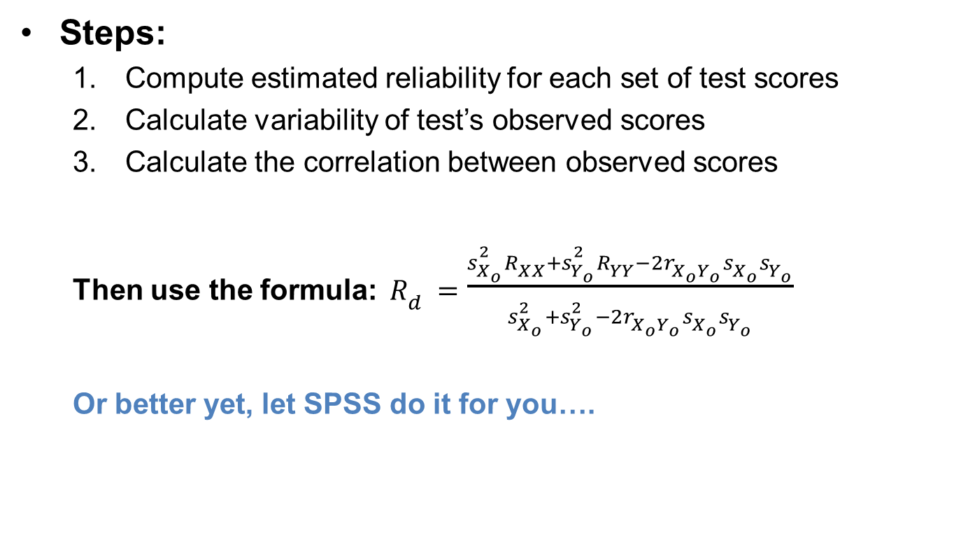
Reliability of Difference Scores
(3 of 8)
Steps:
  Compute estimated reliability for each set of test scores
  Calculate variability of test’s observed scores
  Calculate the correlation between observed scores
  Then use the formula: $R_{d}=\frac{s_{X_{o}}^{2}R_{XX}+s_{Y_{o}}^{2}R_{YY}−2r_{X_{o}Y_{o}}s_{X_{o}}s_{Y_{o}}}{s_{X_{o}}^{2}+s_{Y_{o}}^{2}−2r_{X_{o}Y_{o}}s_{X_{o}}s_{Y_{o}}}$
  Or better yet, let SPSS do it for you….
Notes:
Complexity in the estimation of reliability:
Taking out discussion about difference scores further, we must calculate the reliability of the difference scores.
However, it may puzzle most people about how can the reliability of scores that represent the difference between two scores that are obtained from tests that are themselves unreliable to some degree, be estimated.
Information needed to estimate reliability:
First, the estimated reliability of each set of test scores used to compute the difference scores.
Second, the variability of the tests’ observed scores.
Third, the correlation between the observed test scores.
Application of formulas:
The formula to calculate the difference scores is $D_{i}=R_{i2}−R_{i1}$.
Once this has been calculated, then the reliability is computed using the following formula:
$R_{d}=\frac{s_{X_{o}}^{2}R_{XX}+s_{Y_{o}}^{2}R_{YY}−2r_{X_{o}Y_{o}}s_{X_{o}}s_{Y_{o}}}{s_{X_{o}}^{2}+s_{Y_{o}}^{2}−2r_{X_{o}Y_{o}}s_{X_{o}}s_{Y_{o}}}$.
Understanding the poor reliability:
Sometimes, the reliability of the difference score can be poorer than the reliability of either of its two components.
To understand this condition, one needs some insights into the factors affecting the reliability of difference scores.

Slide 19
Reliability of Difference Scores
(4 of 8)
Factors Affecting the Reliability of Difference Scores
  Reliable if both sets of test scores are reliable
  Lower reliability when two tests are highly correlated
    Why?
    As the correlation goes up, difference between scores goes down!
Notes:
Correlation between the observed scores:
When two tests are highly correlated to one another, then the difference score has a low reliability.
By considering the formula for reliability of difference score, we understand that all else being equal, we can interpret that as the size of the correlation increases, the size of difference scores decreases.
The same can be represented graphically by plotting the reliabilities of the difference scores (y axis) against the different levels of that correlation (x axis).
As the correlation between tests increases and moves along the x-axis from left to right, the reliability of the difference score decreases.
Reliability of the two sets of test scores:
In general, difference scores will be relatively reliable when the two individual sets of test scores are highly reliable.
This can be proved by taking random example too.
In a graph the differences between the lines, at any given point on the x-axis, the lines associated with tests that have high reliability are always higher than the lines associated with tests that have lower reliability.
Summary of key points about reliability of difference scores:
When the two individual tests are relatively uncorrelated, then the difference scores will be relatively reliable (assuming all else are equal).
Again, assuming that all else is equal, it can be stated that difference scores will be relatively reliable when the two individual tests produce scores that are themselves highly reliable.
Next, the reliability of difference scores will not be higher than the average reliability of the two individual test scores.
And finally, the reliability of difference scores can be much smaller than the reliability of the two sets of individual test scores.

Slide 20
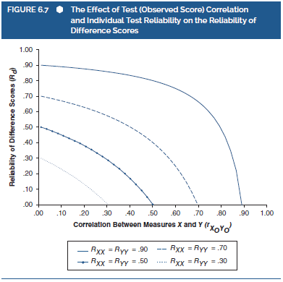
Reliability of Difference Scores
(5 of 8)
Notes:
Figure 6.7: The effect of test (observed score) correlation and individual test reliability on the reliability of difference scores.

Slide 21
Reliability of Difference Scores
(6 of 8)
Problems w/ difference scores
  Unclear reflection of psychological reality.
  Only reflect the two variables used to compute them
Example: Examining GPA and SAT scores for discrepancies.
  SAT – GPA = discrepancy
  Differences are arbitrary, so how should they be interpreted?
  Could just as easily compute discrepancy as (SAT/1000) – GPA
    Variability remains the same, but the actual scores change dramatically
Notes:
Unclear reflection of psychological reality:
Difference scores are simple and popular.
However, they pose some problems and the most important one is their inability to offer a a clear reflection of a meaningful psychological reality.
Also, difference scores reflect only one of the two variables that are used to compute them, thus making them unsuitable for cases emphasizing on change, dissimilarity, and so on.
Example: examining GPA and SAT scores for discrepancies:
Consider a case in which the classroom performance (GPA scores) and standardized testing performance (SAT scores) of a group of students are examined for discrepancies.
While we may tend to create discrepancy scores by subtracting a student’s GPA from his or her SAT score, such scores would not be psychologically meaningful as a discrepancy score.
Assume the SAT scores of four students, Emily, John, Sarah, and Mark are 1000, 1000, 1003, and 1006, respectively. Their corresponding GPA scores are 2.5, 1, 4, and 2.5.
When the discrepancy score is calculated through the normal subtraction method, we end with large positive difference scores for each student.
Issues in interpretation and use:
The scores obtained through this method create a big issue in terms of interpretation and use.
The data obtained may lead to invalid interpretations and considering the difference between the tests is arbitrary, we could divide the SAT scores by 1000, arbitrarily.
However, the variability among the three SAT scores will remain relationally constant, the difference scores would change dramatically.

Slide 22
Reliability of Difference Scores
(7 of 8)
Problems w/ difference scores:
  Tend to lack variability, which could mask meaningful differences in their component scores
  May be highly correlated w/ one component score
  Example:
    SAT – GPA scores
    In this case, the difference scores are almost perfectly correlated w/ SAT
    So are we actually getting at a difference or just measuring SAT w/ extra steps?
Notes:
Other problems in variability among difference scores:
First, the lack of variability in the difference scores will mask the clear and meaningful differences in their component scores.
Second, the difference scores are almost perfectly correlated with the SAT scores and this implies that by examining difference scores, we are essentially studying the SAT scores.
With anything that is associated with the difference scores being essentially associated with SAT scores (usually associates with scores having the higher variance), it is not possible to accurately interpret the discrepancy between classroom performance and standardized test ability.
Clearly, the source of all these problems comes when the two tests have unequal variabilities.
Standardization before calculating difference scores:
While handling two tests with very different variabilities, the feasible solution could be standardization of the test scores before calculation of difference scores.
Consider the example of Emily, John, Sarah, and Mark, and standardize their scores, followed by calculation of the difference scores.
The resulting difference scores would be −90, 0.51, −1.11, and 1.51, respectively.
Ideally, positive difference scores obtained indicate the superiority of standardized test performance over classroom performance.

Slide 23
Reliability of Difference Scores
(8 of 8)
Difference Scores: Summary and Caution
  Perceived as problematic since they may be less reliable than test scores
  If not careful, can lead to meaningless results!
Notes:
Concerns about difference scores:
Difference scores are often perceived as problematic because they are apparently less reliable than test scores.
Difference scores, for many reasons, can have poor psychometric quality and thus lead to questionable psychological conclusions.
In addition to this, some of these problems that occur with difference scores are simply ignored or failed to be addressed by researchers.
This leads to psychological flaws and meaningless or misleading results.
Relationship between difference score reliability and test score correlation.
Often, the inverse relationship between the reliability of difference scores and the correlation between test scores can lead to confusing situations.
For instance, in many schools, the discrepancy between a child’s score on a standard intelligence test and the score on an academic achievement test are compared to deduct a learning disability.
A high correlation between the two tests creates a low reliability for the difference scores between the two tests, thus leading to questionable decisions in practice.
Controversy about quality and reliability of difference scores:
Studies by Rogosa, Zimmerman, and Williams showcase factors that contribute to size of difference scores reliabilities, and that under some special circumstances, difference score reliabilities can be larger than the average of the test reliabilities contributing to the difference scores.
According to Rogosa, when simplifying assumptions upon which the reliability of difference scores depend, do not hold true, difference scores might be quite reliable.
This again leads to researchers being more cautious and careful while working with difference scores.

